Slide 1
Talking to a doctor has never been easier: How to set up your Teladoc Health account

Slide 2
How to: Set up an account from a computer

Slide 3
Desktop Instructions
Enter basic information about yourself like name, DOB, ZIP code, etc. to confirm your eligibility
Click “next”

Slide 4
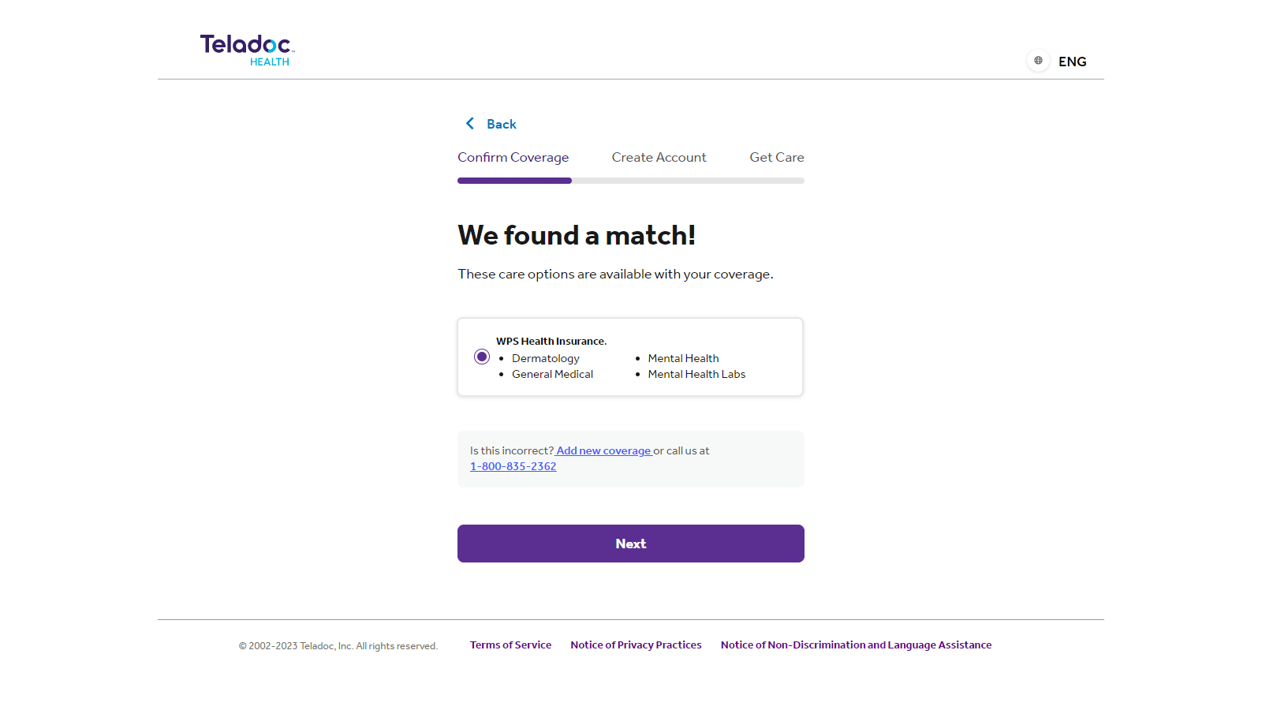
Desktop Instructions
If your benefits were found, select WPS Health Insurance
And click “next”

Slide 5
Desktop Instructions
If you are registering for an account with your new WPS benefits but had coverage through a previous health plan or employer, you may receive a different screen.
You will need to create a new account with your WPS benefits information.
Health plan XYX

Slide 6
Desktop Instructions
If you are registering for an account with your new information but your WPS benefits cannot be found, this is due to information entered not matching up exactly with what’s on the eligibility file.
WPS will not be in the health insurance drop down due to the eligibility verification method set up between Teladoc and WPS.
If this happens to you, please call Teladoc customer service. Using your name and DOB, customer service can look you up in our system & help you register.

Slide 7
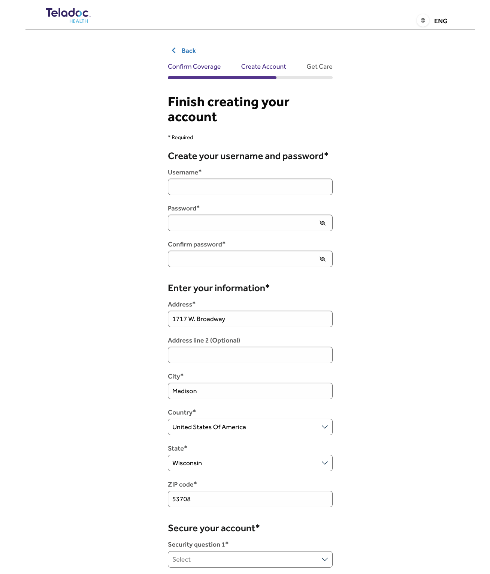
Desktop Instructions
Create your username, password and set your security questions and answers to ensure your account is secure
Click “create account”

Slide 8
How to: Set up an account from the mobile app

Slide 9
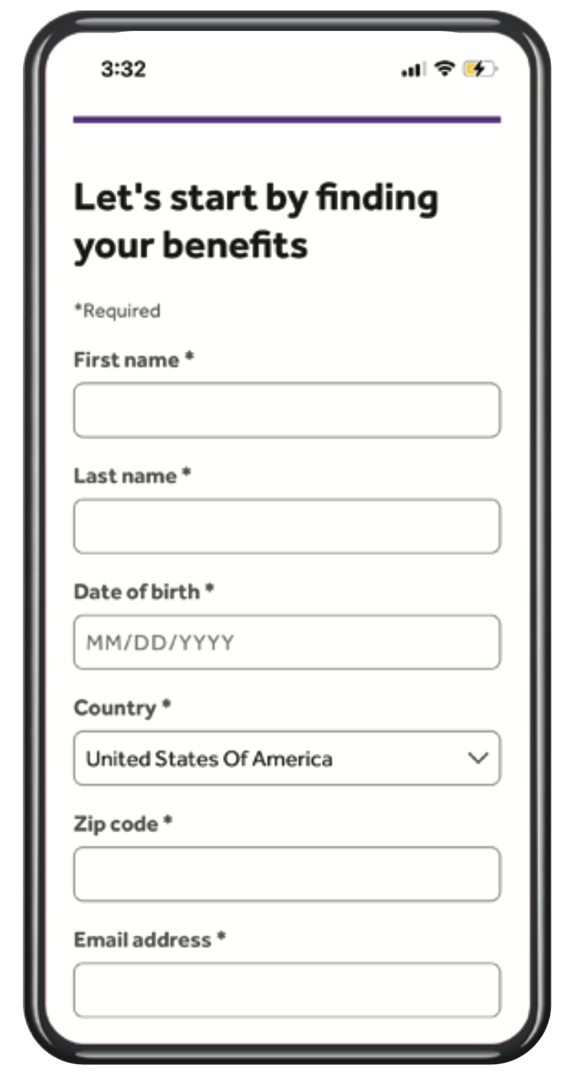
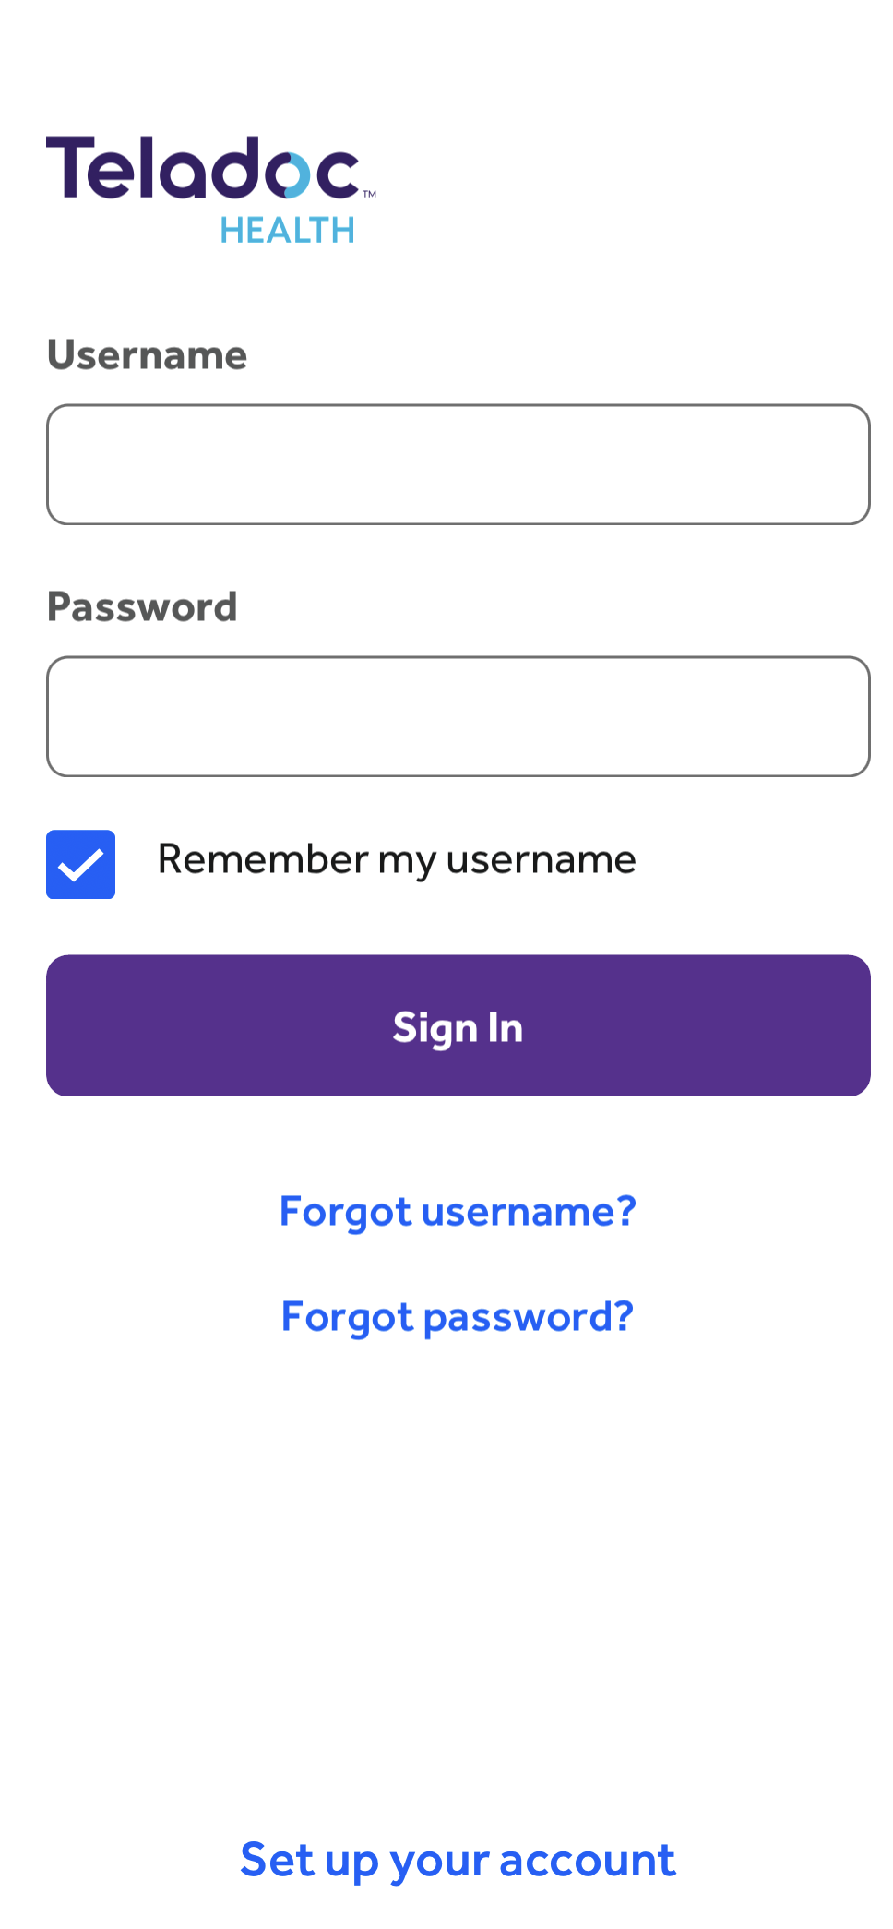
Mobile App Instructions
Download the Teladoc app on either the Apple app store or the Android Google play store
Open the app and click “set up your account”

Slide 10
Mobile App Instructions
Enter basic information about yourself like name, DOB, ZIP code, etc. to confirm your eligibility
Click “continue”

Slide 11
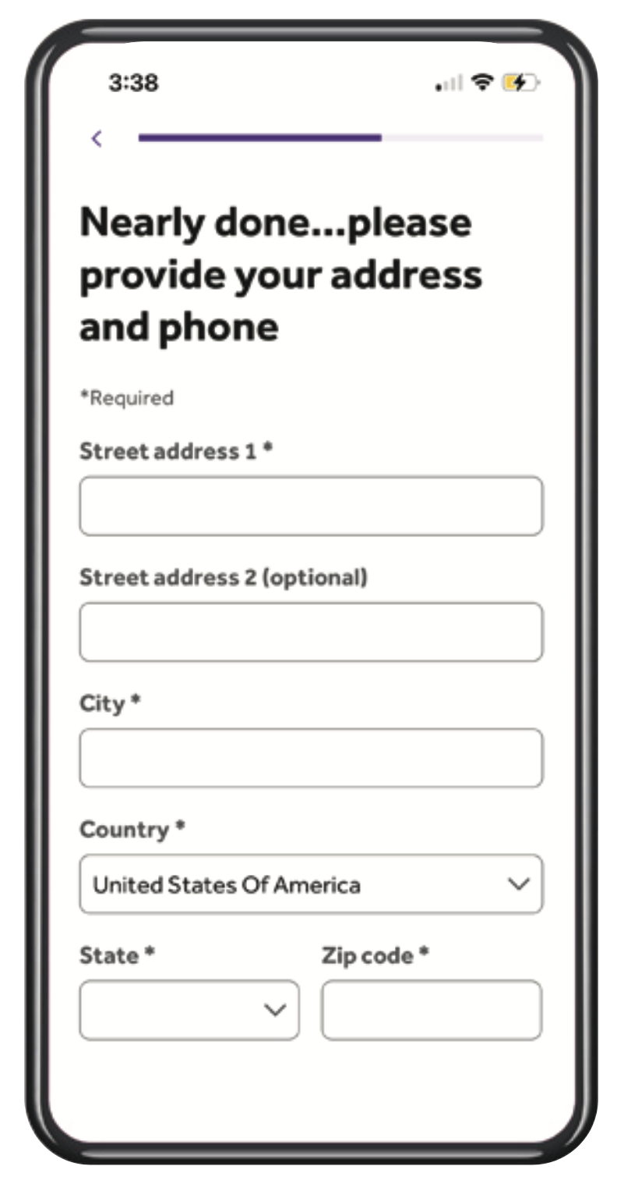
Mobile App Instructions
If your benefits were found, continue by filling in contact information, including address and phone number.
If your benefits were not found, you’ll be prompted to enter more information to better help us look you up.
WPS will not be in the health insurance drop down due to your benefits provider’s eligibility verification method. If this happens to you, please call Teladoc customer service.

Slide 12
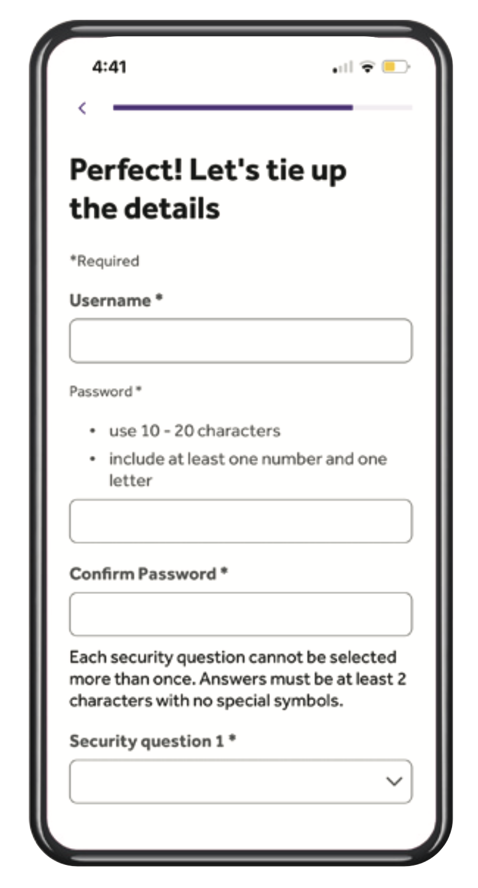
Mobile App Instructions
Create your username, password and set your security questions and answers to ensure your account is secure
Click “complete registration”

Slide 13
Thank you

